Slide 1
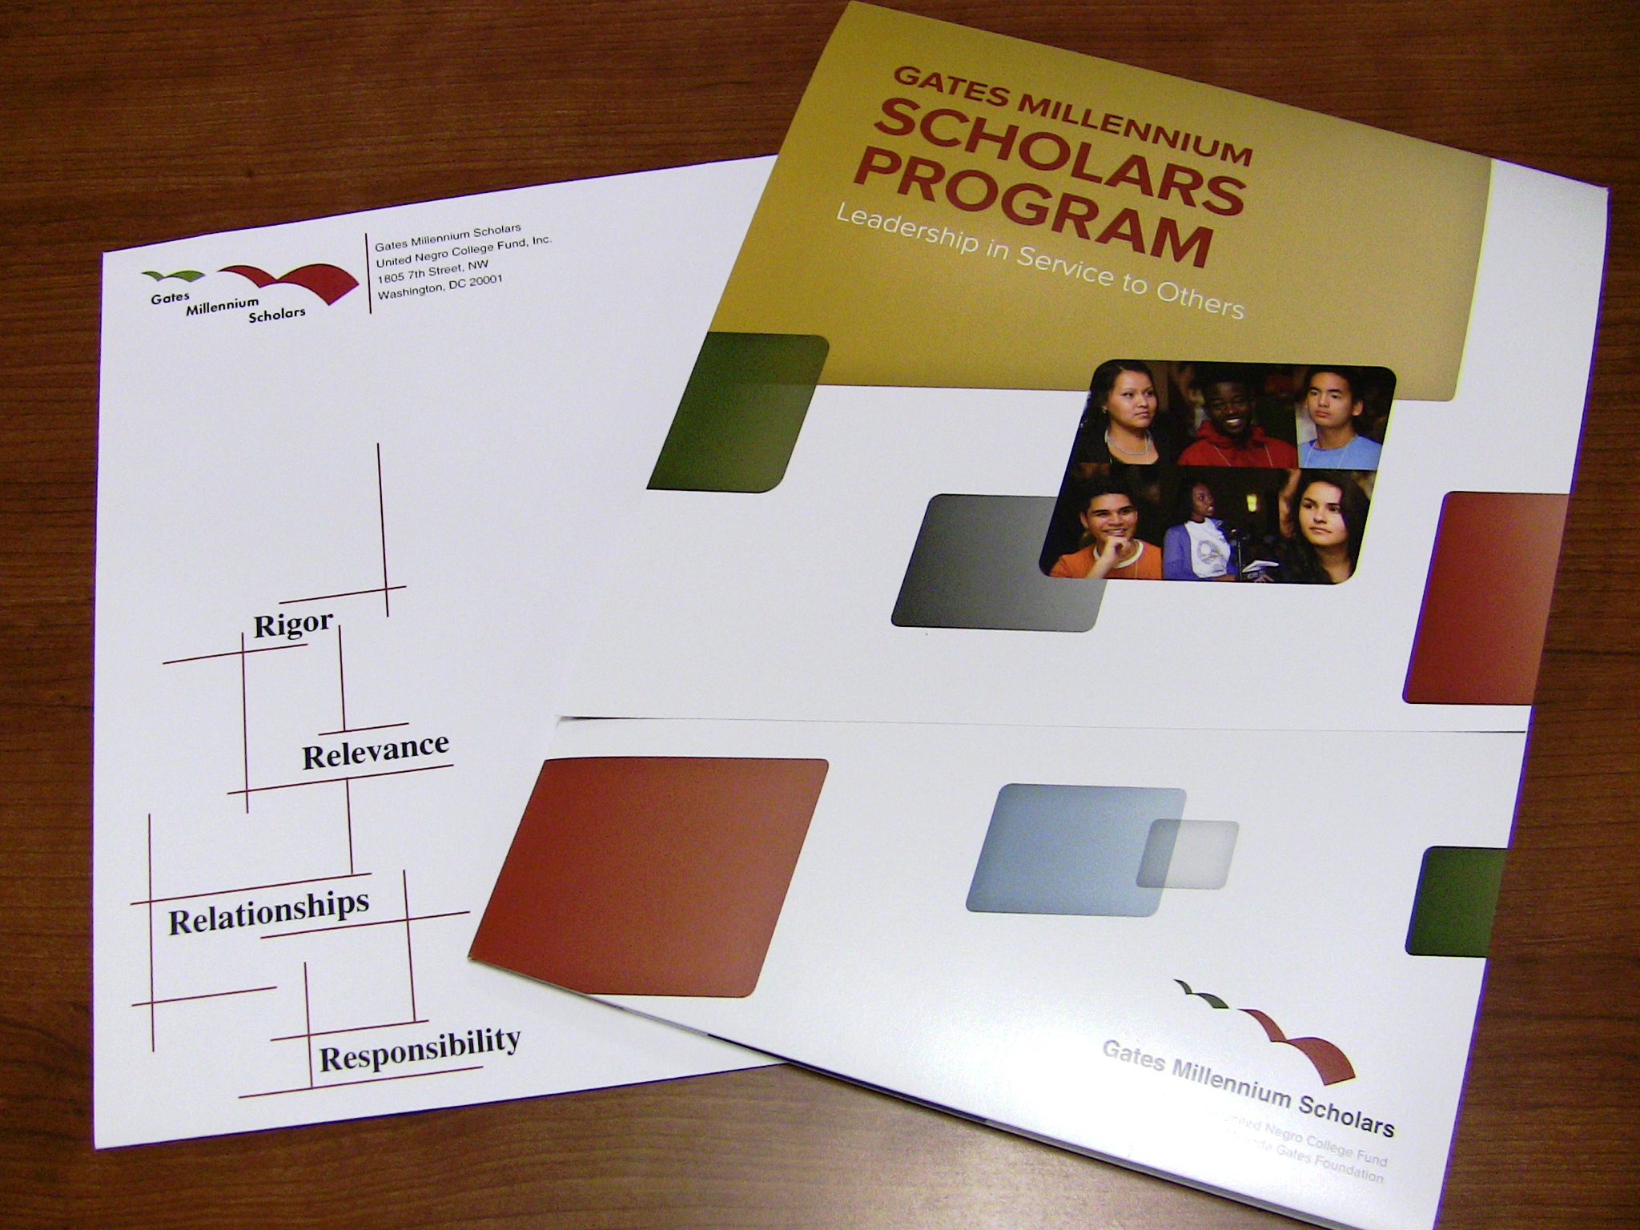

Slide 2

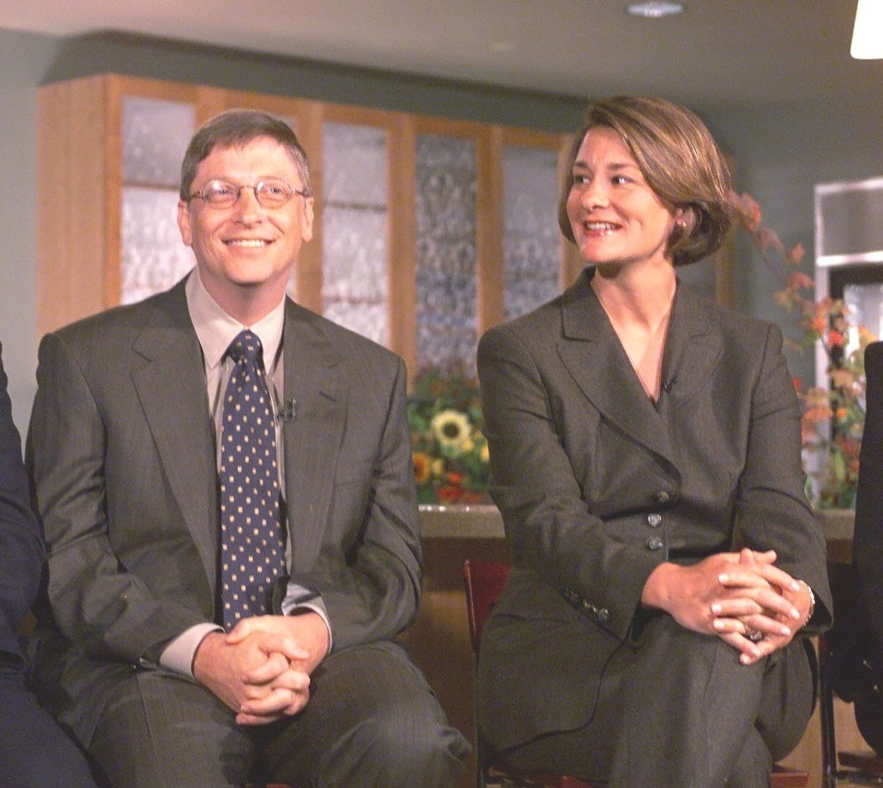
Gates Millennium Scholars Program
Our Purpose
The Gates Millennium Scholars (GMS) program, established in 1999, is a 1.6 billion dollar initiative funded by grant from the Bill & Melinda Gates Foundation.
The goal of GMS is to promote academic excellence and to provide an opportunity for 20,000 outstanding students with significant financial need to reach their full potential.

Slide 3








About the Program
UNCF- the United Negro College Fund is the administrator of the GMS initiative and has partnered with the following organizations:
Asian & Pacific Islander American Scholarship Fund
American Indian Graduate Center Scholars
Hispanic Scholarship Fund

Slide 4
GMS Program Overview
Selects 1,000 candidates a year
Funds unmet need as determined by the financial aid award letter provided by the institution
Provides opportunity for college education in any discipline or field for undergraduates
Provides graduate degree funding for continuing Scholars in: mathematics, computer science, science, engineering, education or library science, and public health
Renews annually based on satisfactory academic progress, full-time enrollment and timely submission of required documents

Slide 5

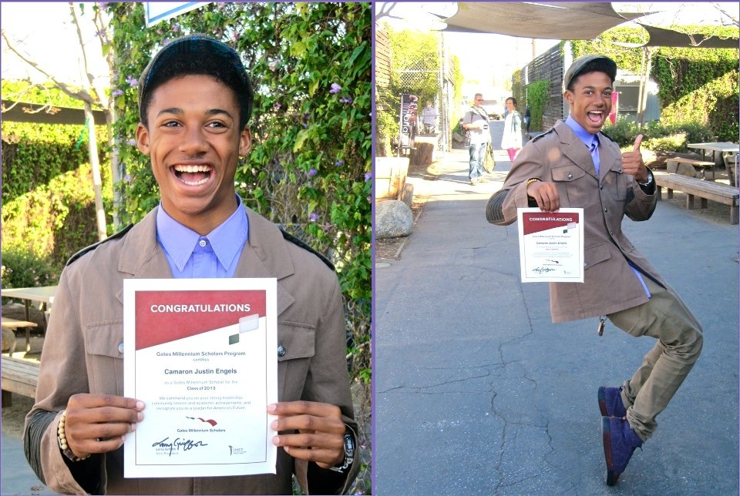
GMS Program Overview Scholarship Awards
GMS selects 1,000 new Scholars each year, funding over 19,000 Gates Scholars since 2000
GMS has awarded $845,713,056 in scholarships between the 2000-2014 academic years
The average award was $12,492 between the 2001-2014 academic years

Slide 6
GMS Program Overview Eligibility Criteria
African American, American Indian/Alaska Native, Asian Pacific American or Hispanic Americans;
Citizens/permanent residents of the United States;
Cumulative GPA of 3.3 on a 4.0 scale;
Matriculation for the first time at an accredited college or university as full-time, degree-seeking freshmen in the fall of 2015, with exception of students jointly enrolled in high school and college ; GED recipients are also eligible
Significant demonstrated financial need as defined by Federal Pell Grant eligibility criteria; and
Demonstrated leadership commitment through participation in community service, extracurricular or other activities that reflect leadership abilities.

Slide 7


TIP #1
Familiarize yourself with the entire application process
Read the questions carefully.
Read your responses out loud
Ask a teacher, counselor, or parent to review the application with you

Slide 8

TIP #2
Understand the evaluation criteria
Academic Merit
Leadership Potential
Creativity
Community Service

Slide 9


TIP #3
Select the appropriate nominator and recommender
Do I have a positive relationship with my recommender or nominator?
Does my recommender or nominator have the time to write my recommendation or nomination prior to the deadline?
How many nominators or recommenders do I need?

Slide 10

TIP #4
Tell your story
Who am I ?
What are some of my accomplishments?
What activities, clubs or organizations am I involved in?
What obstacles have I overcome ?
What makes me unique ?
What are my future academic & career goals ?

Slide 11


TIP #5
Create a timeline to ensure your application is complete before the deadline
Complete sections of the application weekly.
Contact and follow-up with your recommenders and nominators to ensure they have submitted their forms prior to the deadline.
Create a timeline check-off list ensure that you are progressing to complete your application prior to the deadline.
Select a submission date prior to the actual deadline

Slide 12


THE GMS EFFECT

Slide 13
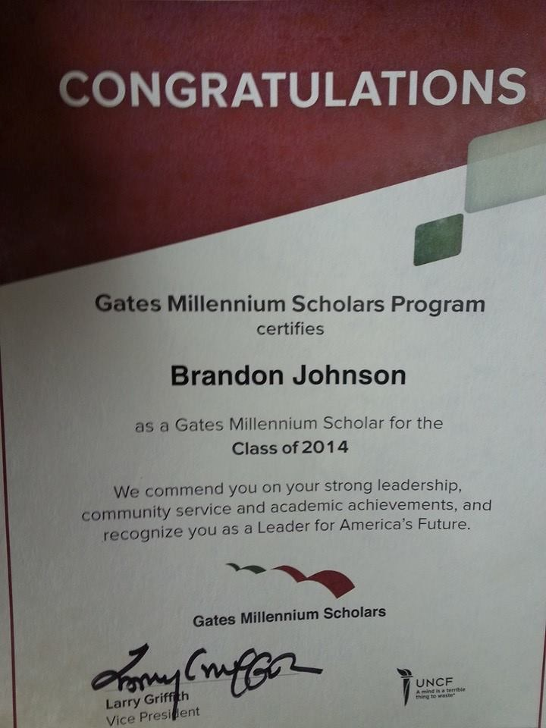
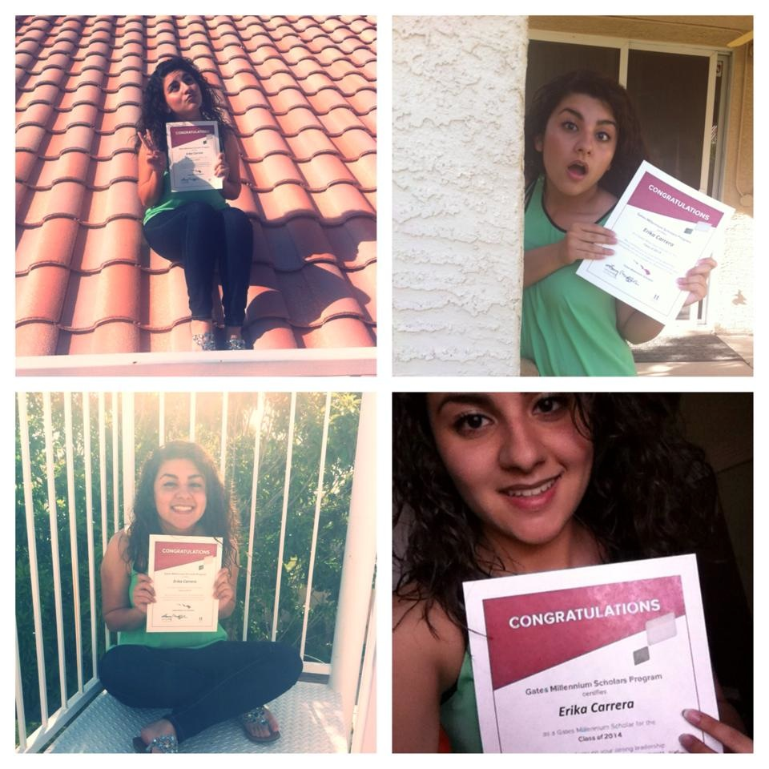
]

Slide 14
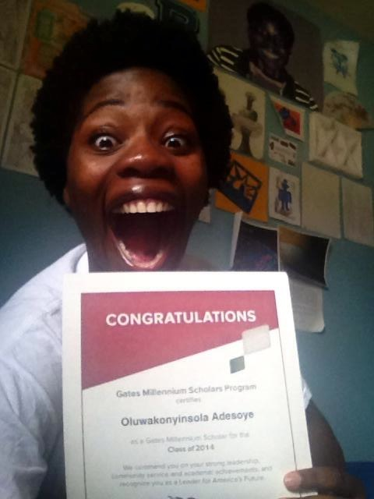
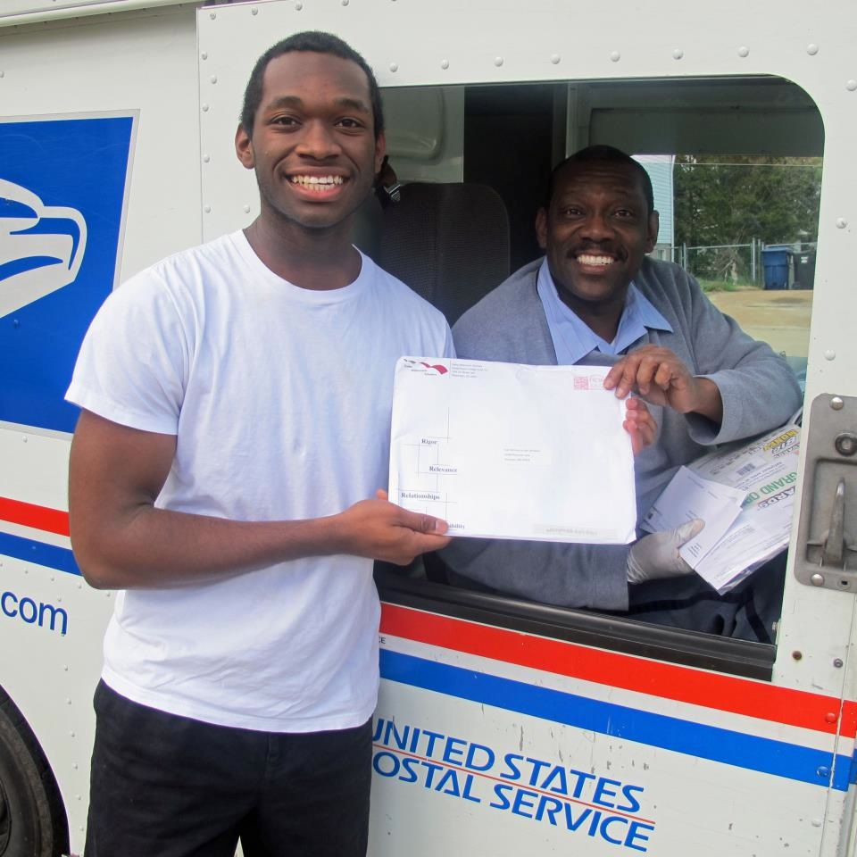
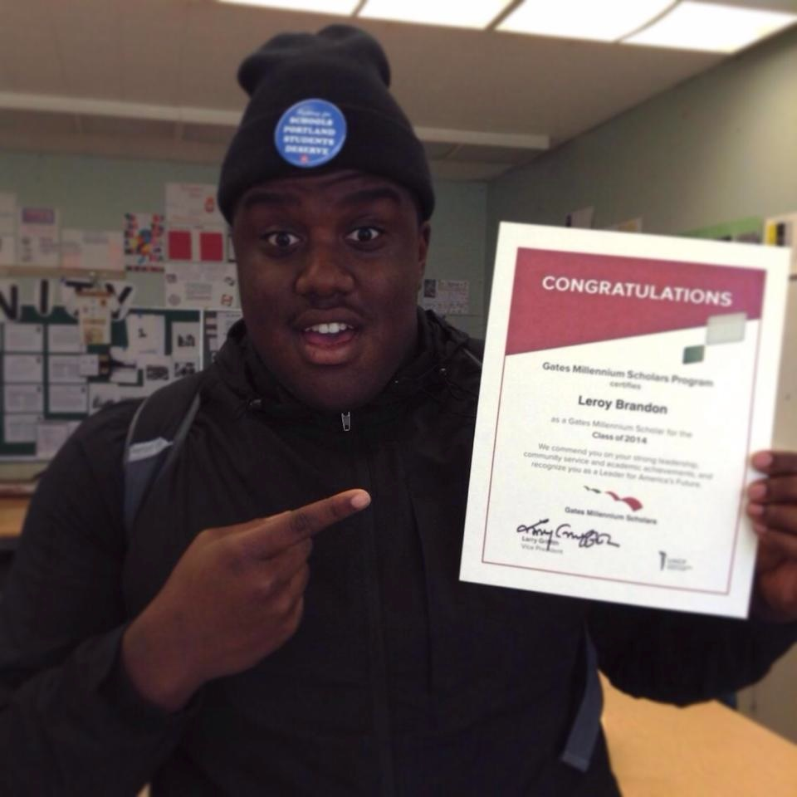
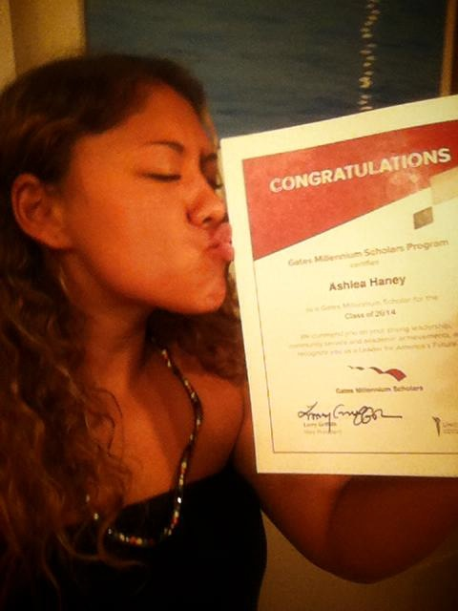

Slide 15

Applying for UNCF Scholarships
Students can apply for all UNCF scholarships directly by registering on UNCF's website www.uncf.org. Registering on-line will result in the student creating their individual homepage where they can visit on a regular basis to check on the status of their application. Student must meet the general eligibility criteria to be considered for a UNCF scholarship.

Slide 16
The general criteria for UNCF scholarships includes the following :
Students must have a minimum grade point average of 2.5.
Students must have an unmet financial need as verified by a financial aid officer at your selected college or university.
Students must complete the Free Application for Federal Student Aid form (FAFSA) and request that the Student Analysis Report (SAR) is sent to the financial aid officer at the college or university.
Students must be enrolled full-time.
Students can visit the UNCF website www.uncf.org
for additional information about scholarships.

Slide 17


Contact Us
www.gmsp.org
Toll Free #
1877-690-4677
Application Deadline:
January 13th, 2016

Slide 18

Contact Me
Email: BJohnson1@Rollins.edu
Number:
((407) 252-4656

